Slide 1

Street
Complete
How does the editor handle edits?
Tobias Zwick

Slide 2

Section 1
Data Flow
Notes:
Look at architecture of the app → where does the data flow?

Slide 3
Let’s do this iteratively
Disclaimer: It’s simplified
Detailed overview at lstu.fr/sc-data-flow
Notes:
Non-shortened URL:
https://raw.githubusercontent.com/streetcomplete/StreetComplete/master/res/documentation/overview_data_flow.svg

Slide 4
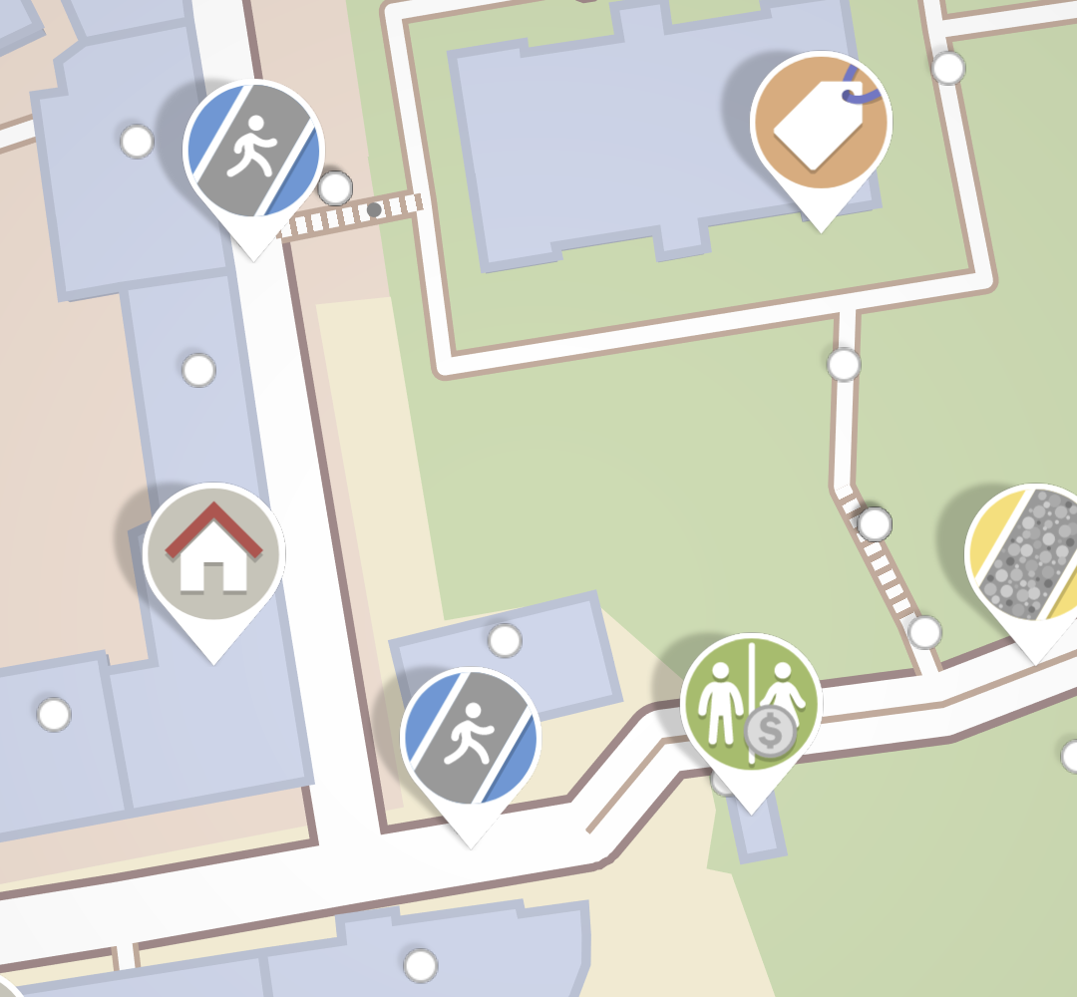
OSM Api
download & create quests
no connection?
upload changes
UI
Notes:
But:
Must download everything again on restart of app
doesn’t work offline, edit lost if upload fails

Slide 5
Quests
OSM Api
download & create
new quests based
on edits?
Edits
upload
UI
Notes:
persist it into local storage...
Edits are not lost when upload fails, etc
(also cool: edits are all clearly separate)
Note:
UI is updated when Quests change
Upload is triggered when Edits change
But, we want more:
Not really working on OSM data: Example with building → building levels / housenumbers

Slide 6
new download overwrites
local changes?
Quests
OSM Api
download
Map data
upload
changes
Edits
UI
how to undo edits now?
Notes:
Explain flow: download leads to updated map data, leads to created quests, leads to updated UI etc
→ quests are updated based on our edits! Yay!
But:
Undo?! Difficult – the app would need to know how to reverse an edit. Reverse a way split, anyone?
Also: edits are not separated on upload anymore – what if there is a conflict?! Drop everything?

Slide 7
Original
map data
OSM Api
local
map data
Quests
UI
Edits
StreetComplete
Notes:
Explain flow:
Only download and updating after upload updates original
Either original or edits changes → propagate change etc (take original + apply edits)
Explain that local map data basically keeps around a cached version of local edits
That’s the data flow in SC

Slide 8
✔ Work with map data offline
(honk honk)
✔ Easy undo, undo edits in any order
✔ Easy conflict handling: Per edit
Notes:
So to recap
Work with map data offline
→ honk honk: this is the basic requirement for any general purpose editor - but SC is no general purpose editor
BUT, on top of that, retains capability to….:
Easy undo (just remove the edit), undo edits in any order
Upload per-edit – easy conflict handling (later more)

Slide 9

Section 2
The edit queue

Slide 10
What is an edit anyway?
an atomic action from user perspective
it contains...
original map element it refers to
type of edit, each type has own logic
necessary info that describes what is changed
Notes:
original map element for reference (f.e. decide if edit should still be applied)

Slide 11
Example: Split way
an atomic action from user perspective
Notes:
Short excursion – what is an atomic action from user perspective?
OSM Api is very low level – no notion of combining ways, splitting ways, joining areas → all those are client-side features
Explain what needs to be done.
JOSM split way is 2-6

Slide 12
Example: Split way
an atomic action from user perspective
Notes:
Short excursion – what is an atomic action from user perspective?
OSM Api is very low level – no notion of combining ways, splitting ways, joining areas → all those are client-side features
Explain what needs to be done.
JOSM split way is 2-6

Slide 13
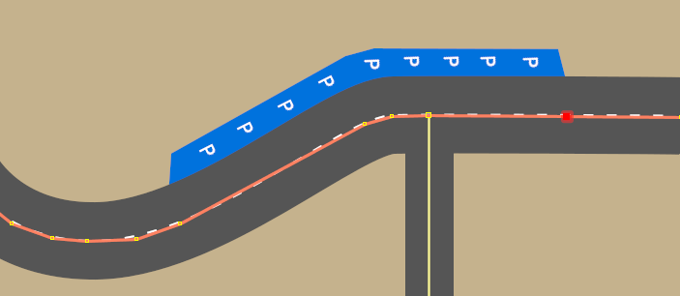

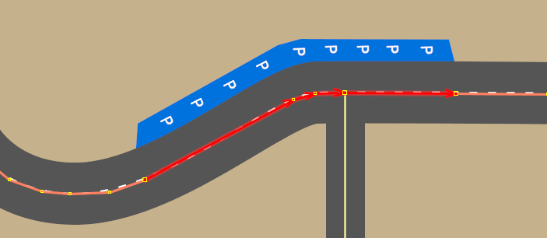
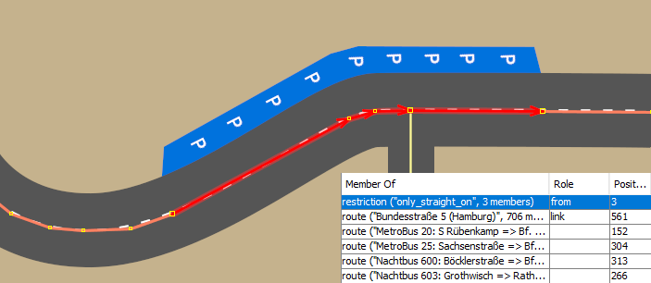
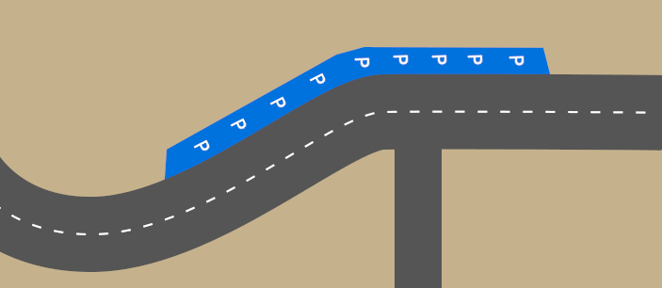
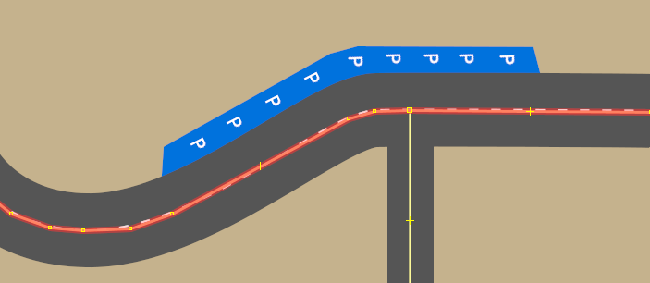
Example: Split way
an atomic action from user perspective
Add vertices at which to split the way
Modify way to only consist of longest segment
Create new ways for all other segments
Copy applicable tags
Insert new ways into relations
+ extra logic for from-to relations
Notes:
Short excursion – what is an atomic action from user perspective?
OSM Api is very low level – no notion of combining ways, splitting ways, joining areas → all those are client-side features
Explain what needs to be done.
JOSM split way is 2-6

Slide 14



Example edit queue
1.
modify bench=no to yes for node #2
2.
split way #3 at lat=53.56543, lon=9.95096
3.
add sidewalk=both for way #3
4.
add sidewalk=left for way #-1
5.
delete building=yes,
add man_made=storage_tank for way #4
Notes:
Simplified, of course
Describe what’s happening
Yeah so it is a queue, applied in order

Slide 15
How does an edit create changes?
Get current version of map data element(s)
Compare original version with current version
Return updated map data elements or reject edit
local
map data
Single
edit
<<interface>>
Map data
repository
OSM Api
Notes:
1: edits need to apply/get data either from local map data, or for upload, from OSM Api → let both implement interface – edit doesn’t know where the data is coming from and where to it should be applied
The interface: f.e. get all relations for a way etc...
2: ...and decide if the change can and should still be applied (tag was changed vs geometry changed significantly)
3: edit itself just return the updated map data → uploader / local map data are in control

Slide 16

Section 3
Undo and Revert

Slide 17
Uploaded edits
Edits whose changes have been uploaded, stay in the queue
...but are marked as uploaded
...so that they are available for undo even after upload

Slide 18

Undo an edit
Delete POI: node #2
already
uploaded?
Just delete the edit
Also delete the edit but also add another edit to the queue, marked as revert:
revive POI: node #2
revert
Notes:
Marked as revert: Because a revert is not undoable and should not appear in the edit history

Slide 19
And that’s it. Thank you!
For a more detailed overview, see lstu.fr/sc-data-flow

